Slide 1


Fairness in NBA Game
Team E2: Manhui Zhu, Tsung-Wei (Weber) Lin, Jeanne Mathé-Cathala, Hazel Gailani, Cong Minh Tran, Botai Zhou, Anna Natasha

Slide 2
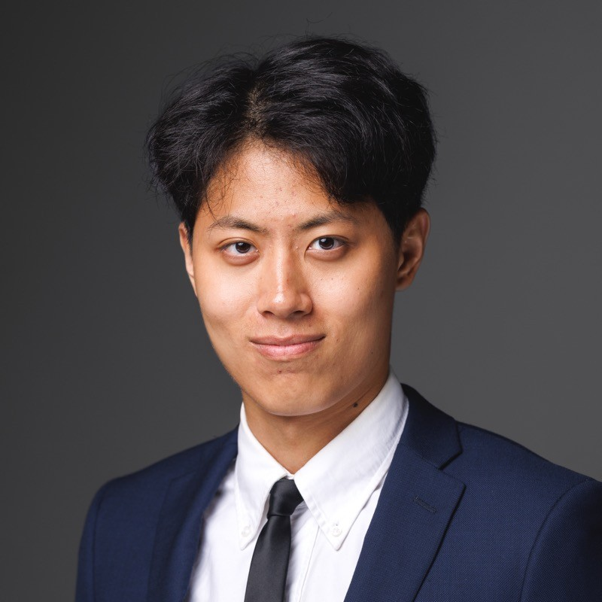
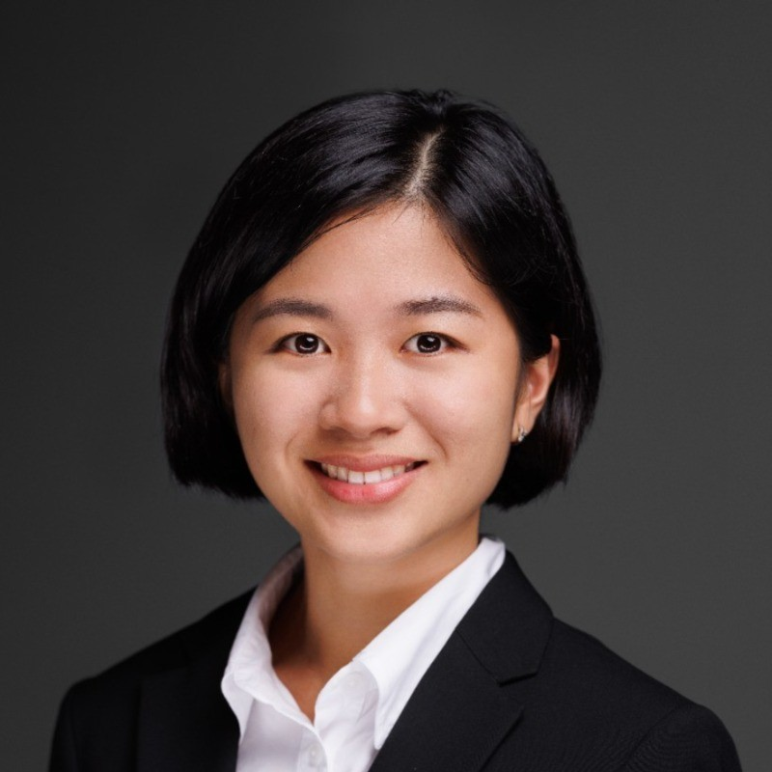

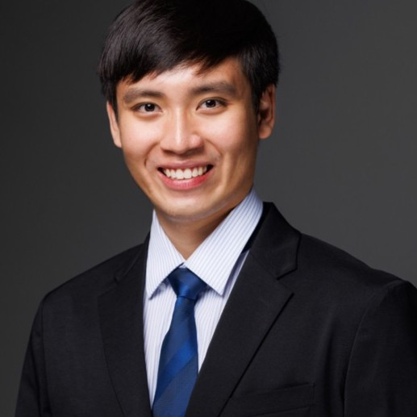



Our Team
Jeanne Mathé-Cathala
Botai Zhou
Anna Natasha
Cong Minh Tran
Manhui Zhu
Hazel Gailani
Tsung-Wei Lin

Slide 3
Summary
1
2
3
4
5
Issue & Possible Outcome
Context
Experiment
Exploratory Data Analysis
Regular Regression Results
What is the problem and possible outcomes?
What is the background of our question?
What is an ideal experiment to examine the issue?
What descriptive statistics describe our data and visualizations?
Result of Regression and Interpretation

Slide 4
Question and Possible Outcome
Is NBA Game Biased or not in the Last 2-minute Call of the Game?
1
A
Outcome
Super teams are favored
B
Outcome
Non-super teams are favored
C
Outcome
Neither supers are non-supers are favored
Reasoning
Team reputation (star players might receive different treatment)
Referee team dynamics

Slide 5
Context
Is NBA Game Biased or not in the Last 2-minute Call of the Game?
2
Team Favored
Y
1. Committing team in Incorrect Non-call (INC)
2. Disadvantaged team in Incorrect Call (IC)
Whether the team is favored by referee in wrong call? (0/1 binary variable)
Are super teams treated more favorably than non-super teams by the referee during the last two minutes of NBA games, suggesting a potential bias of favoring fan’s favorite teams in officiating decisions?
Define Super-teams
Find top 10 players by jersey sales (Super Players) in each season and their team
For team that have more number of Super Players, it is the Super Team in that game
Data: L2M
X
Last Two Minute Report (L2M): review the decisions made by referees in the last 2 minutes of a close game
How many Super stars on the team?
Notes:
Ho: There is no significant difference between popular odds and non-popular teams by referees during the last two minutes of NBA games
Ha: There is significant difference between popular odds and non-popular teams by referees during the last two minutes of NBA games

Slide 6
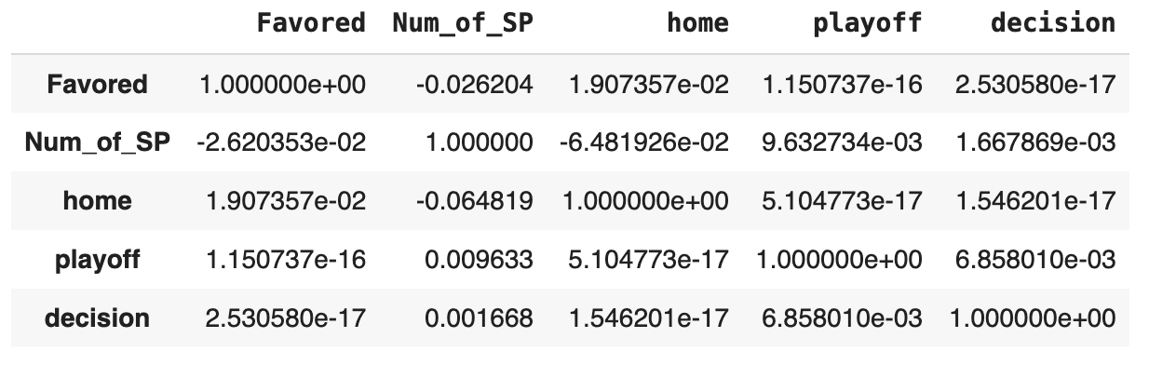
Experiment
What Is the Ideal Experiment to Examine the Issue?
3
Run Regular Regression
Evaluate the Correlation
X: Number of super player in team
Y: Whether the team get favored call or not (0/1 - binary outcome)
Alpha: 5%
We checked other variables that may affect the result:
- Home court advantage (home vs away)
- Playoffs vs Regular season
- Decisions (IC or INC)

Slide 7
Exploratory Data Analysis
Prepare and Clean the Data
4
1. Find a Dataset
2. Assign Super-teams
Dataset: Last Two Minute Report (L2M): review the decisions made by referees in the last 2 minutes of a close game — any game where the lead is 3 points or fewer during the last 2 minutes of the 4th quarter or overtime.
Who is SuperTeam in each game:
The team who have at least one super player is super team
4. Data Cleaning
3. Add New Variables
1.Filter out the rows that have correct calls
2. Delete the irrelevant variables and missing values
3. After adding the new variables, our dataset have 5277 observations and 35 variables
1. Favored_Team
2. Favored_team_is_Super_team (1/0)
3. Number_of_SuperPlayer_in_Superteam
4. Non_favored_team
5. Non_favored_team_is_Super_team (1/0)
6. Number_of_SuperPlayer_in_Superteam

Slide 8
Experiment
Step 2 of our experiment: generate
3
Mean/Median/Histogram of favored called to Super Team (0/1)
Mean/Median/Histogram of favored called for Super Team have different number of Super Star
Mean/Median/Histogram of favored called to Super Team, but the players who get called are not Super player (probability)
Proportion of wrong calls are super players versus non-super players within the superteam
2
3
1
4
EDA questions
5
7
6
Favored called to Super Team by different fall type categories of wrong calls (0/1)
Favored called to Super Team by different type of wrong calls (0/1)
How many super teams per year base on our ranking

Slide 9
Exploratory Data Analysis
Would Referees Favor Teams that Have Super Player than Team that Does not Have Super Player?
4
48.88%

Slide 10
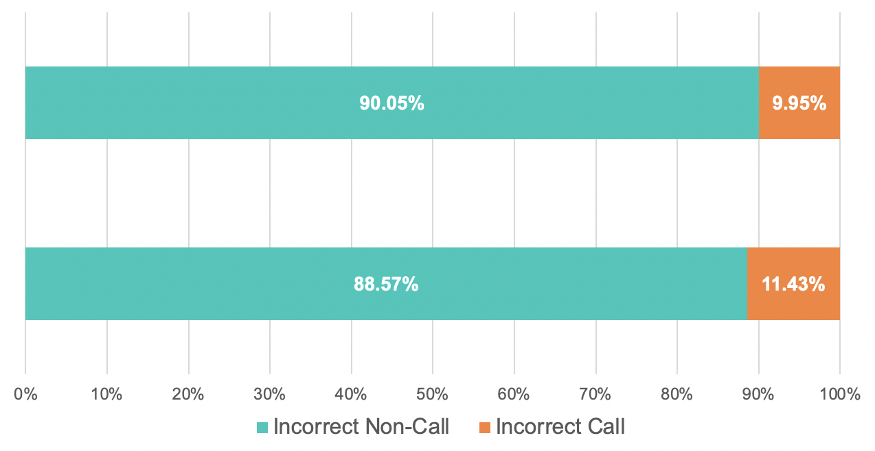
Exploratory Data Analysis
If Referees Give Favor Call to Team that Has at Least One Super Player, How Many of Them Are Incorrect Non-Call and Incorrect Call ?
4
At least one side has Super Player
All Games

Slide 11
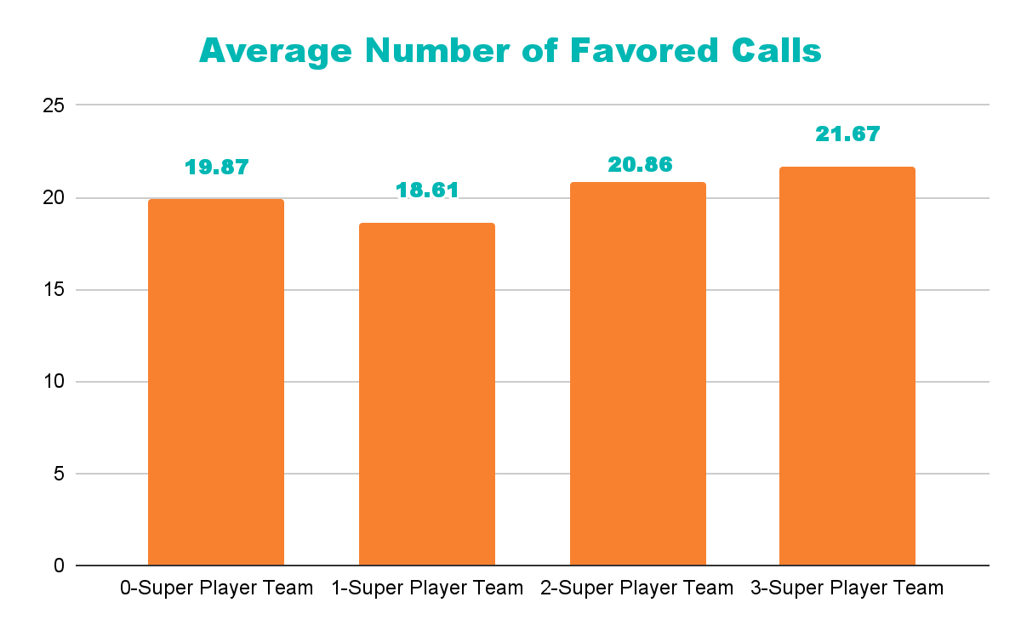
Exploratory Data Analysis
Would Teams that Have Super Player Get More Favored Calls than Team Without Super Player?
4

Slide 12
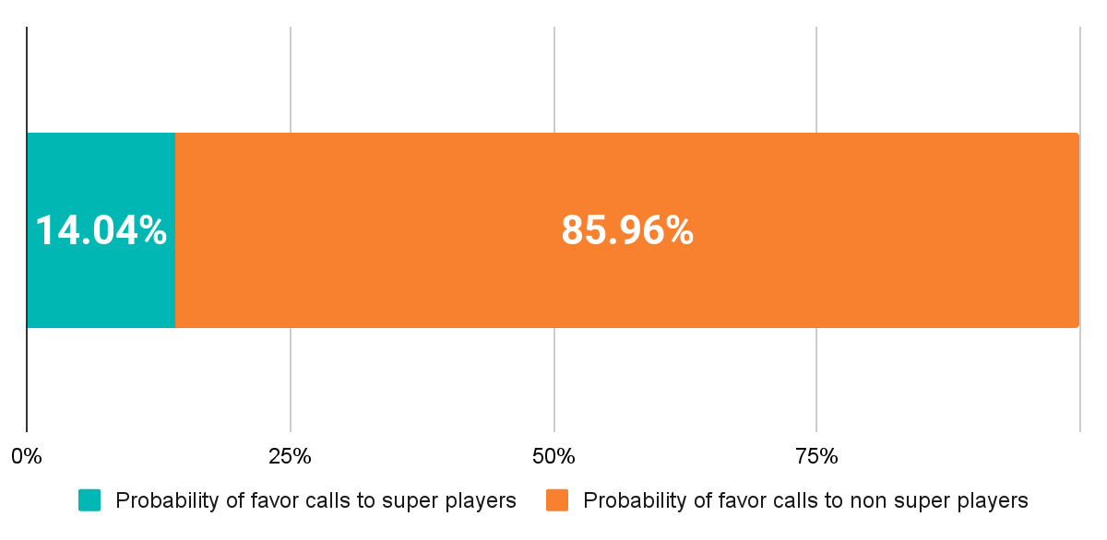
Exploratory Data Analysis
Would Non-Super Player Be Favored by Referee if They Are in A Team with Super Player?
4
For 9 seasons:
26 Super Players 4.06%
615 Non Super Players 95.94%

Slide 13
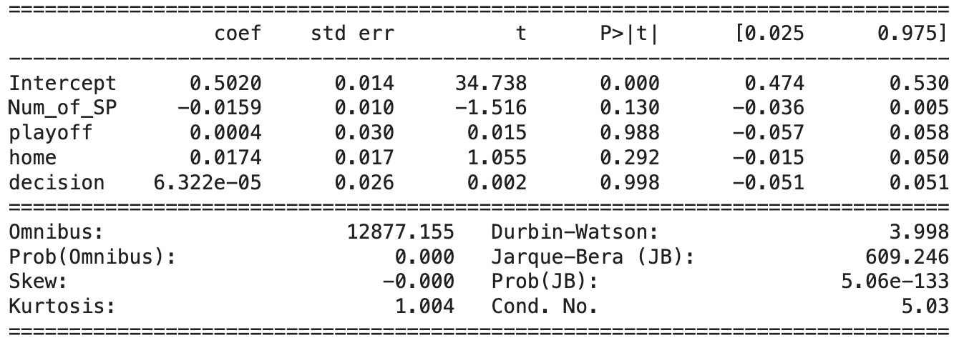
Regular Regression Results: All variables
y : the team is favored or not in the wrong call (1 is yes, 0 is no)
5
x : - Playoff/Regular Season
- # of Super player
- Home/Away Team
- Decision: INC/IC

Slide 14
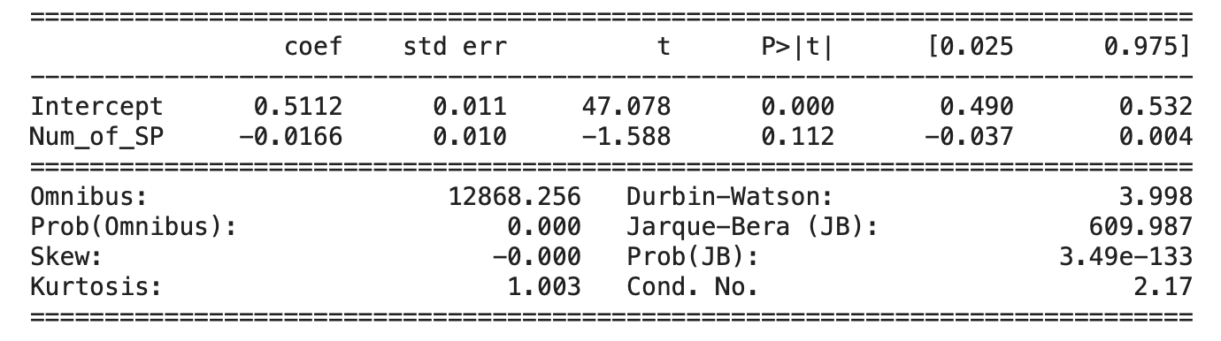
Regular Regression Result
y : the team is favored or not in the wrong call (1 is yes, 0 is no)
x : # of Super player
5

Slide 15
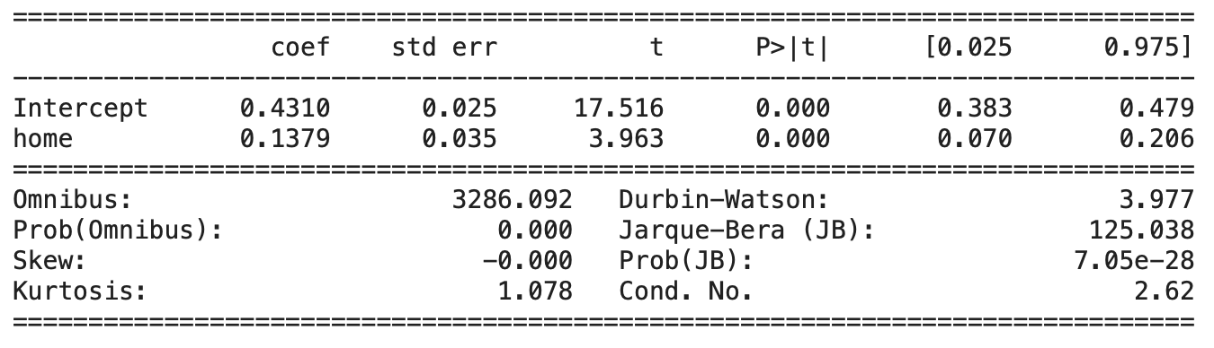
Regular Regression result: only see the playoff games
y : the team is favored or not in the wrong call (1 is yes, 0 is no)
x : - Home/Away Team
5

Slide 16
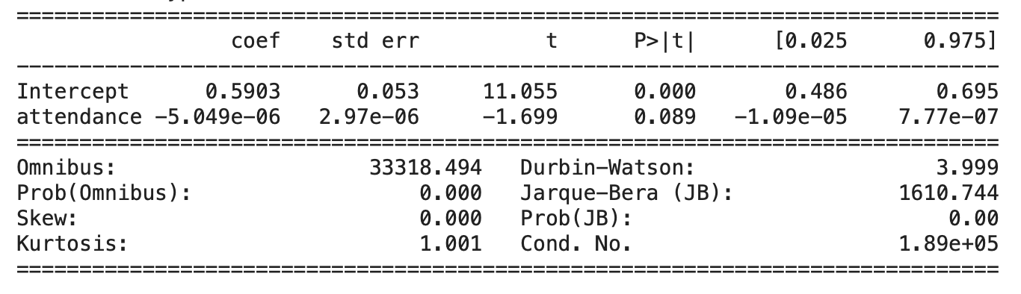
Regular Regression result: change the standard of super team
y : the team is favored or not in the wrong call (1 is yes, 0 is no)
x : attendance
5

